Slide 1
Final Project
Eli Brenckle

Slide 2
Main Goal
Create a platformer, similar to Path of Pain from Hollow Knight, in Unity using powerups such as phasing, double jump, pogo, dash, wall jump, and wall slide.

Slide 3
Basic Unity Explanation
Unity is a game engine that handles the physics aspect of game development such as gravity and collisions.

Slide 4
Rigid Bodies
Rigid bodies apply physics to sprites in Unity such as gravity & friction.

Slide 5
Box Collider & Trigger Bodies
A box collider prevents objects that would intersect with each other from going through each other. Allows for floors and platforms.
A trigger body allows for an object to pass through an area and trigger specified events through programming.

Slide 6
Coroutine & Enumerator
A coroutine is similar to calling a function, however, it provides the ability to use the wait() functions.
An enumerator is the defining of the special kind of function a coroutine calls.

Slide 7
Challenge #1 – Phasing
Idea: Player character can phase through objects such as platforms and specific walls.
Challenge: Player character still needs to be able to be controlled, have gravity, use abilities, trigger actions such as checkpoints, & doesn’t phase through certain walls and floors.

Slide 8
Solution
Create two separate box colliders, one which collides with everything and one that ignores certain layers. This allows the player to phase through specified objects such as platforms and still trigger objects such as checkpoints.

Slide 9
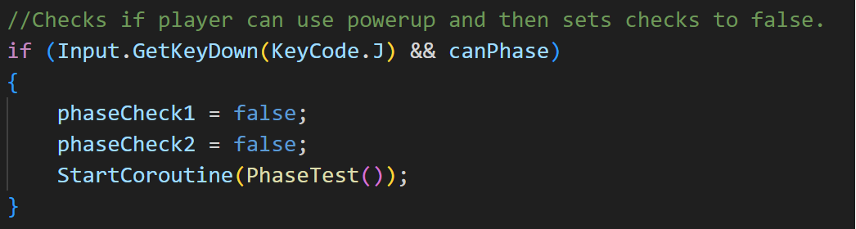
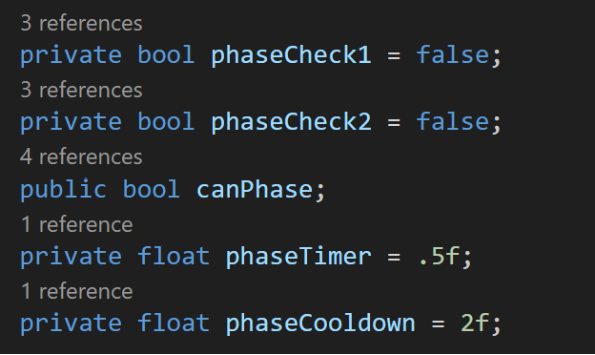
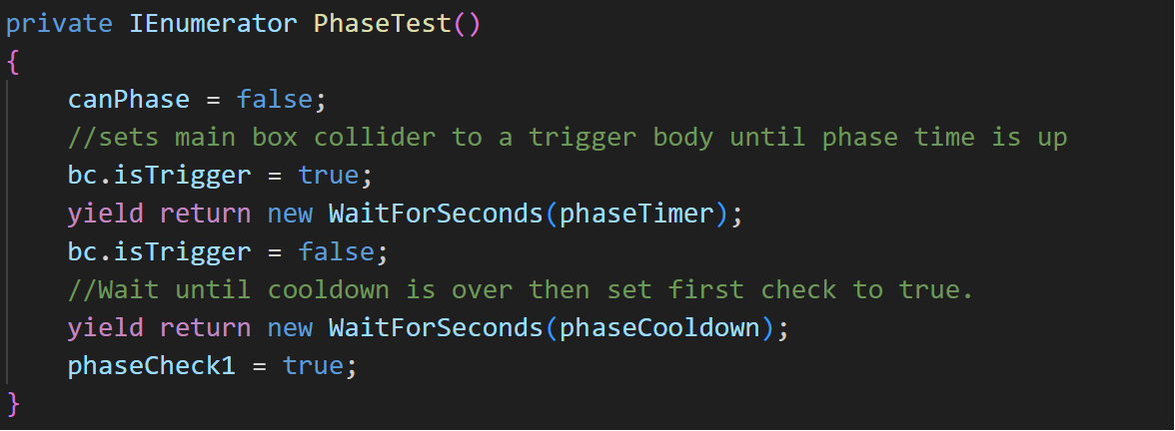
Code

Slide 10
Challenge #2 – Dash
Idea: The player character can dash forward, ignoring gravity for a bit, and resets after cooldown and landing on the floor or wall.
Challenge: Cooldown and ground/wall check aren’t happening independently of one another.

Slide 11
Solution
Store the players gravity in a separate variable for later use. Then set the player gravity to 0 so the dash doesn’t lower height. After the dashing time is up, reset the players gravity to the gravity stored prior to the dash and then check for the cooldown.

Slide 12
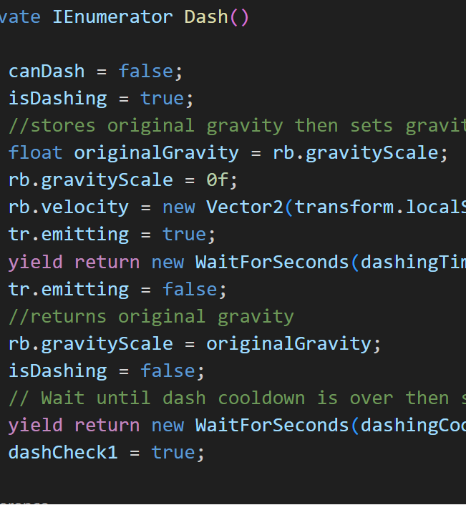
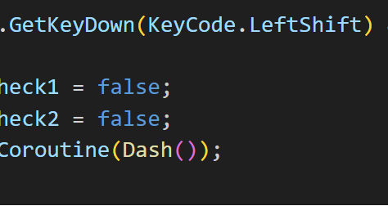
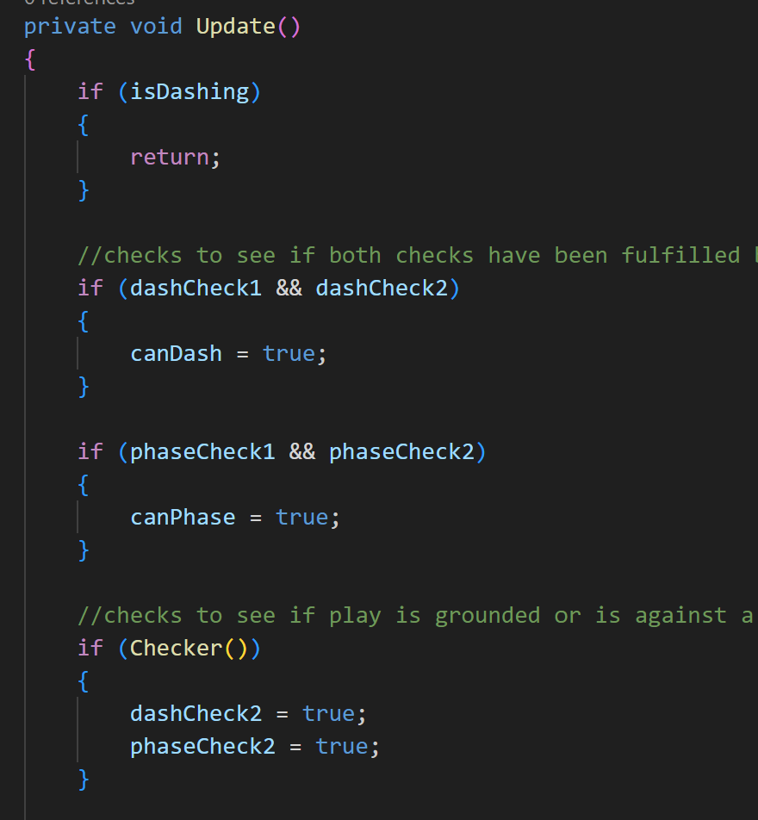
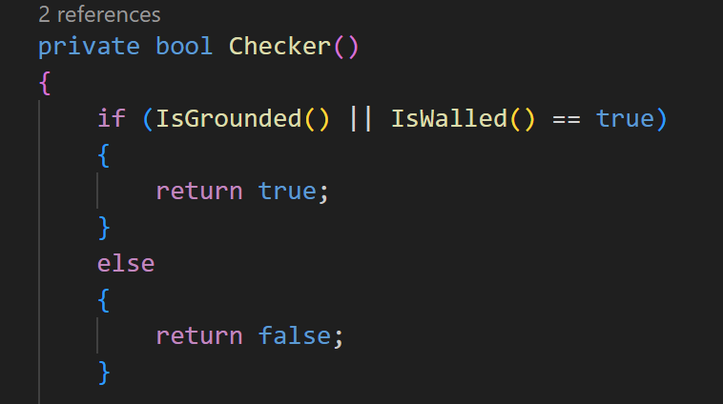
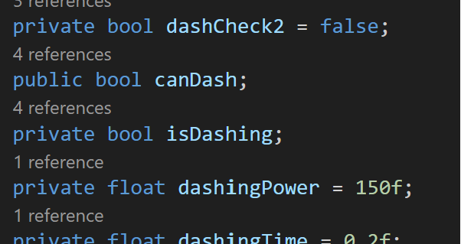
Code

Slide 13
Challenge #3 – Pogo
Idea: Player can attack certain object bellow him to bounce upwards and reset certain abilities.
Challenge: Make sure the code does not interfere with the rest of the abilities and prevent cooldown completion.

Slide 14
Solution
Create an empty container bellow the player that is constantly checking to see if a spike is bellow the player within a certain range. If it is possible to pogo and the command is given, then the player’s vertical velocity is increased. This also sets all variables controlling abilities to true.

Slide 15
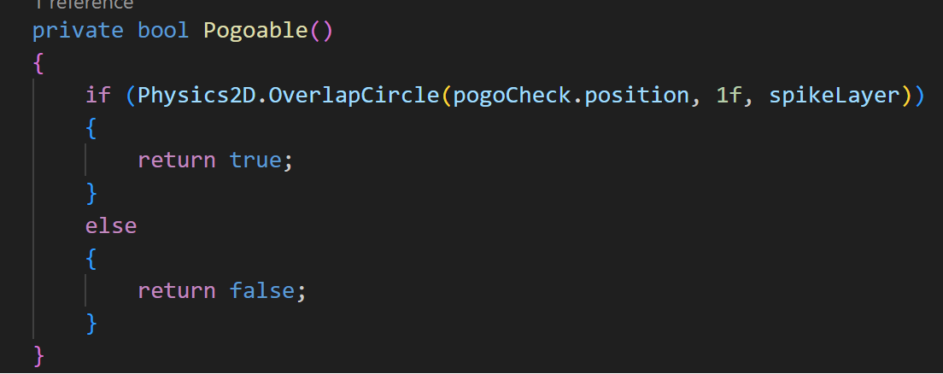
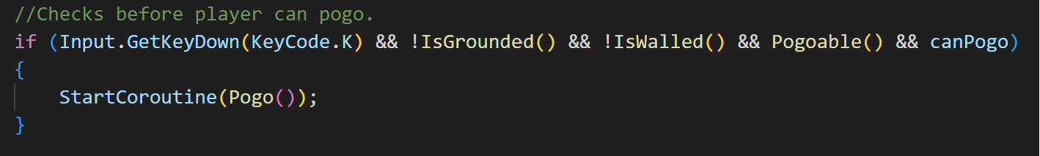
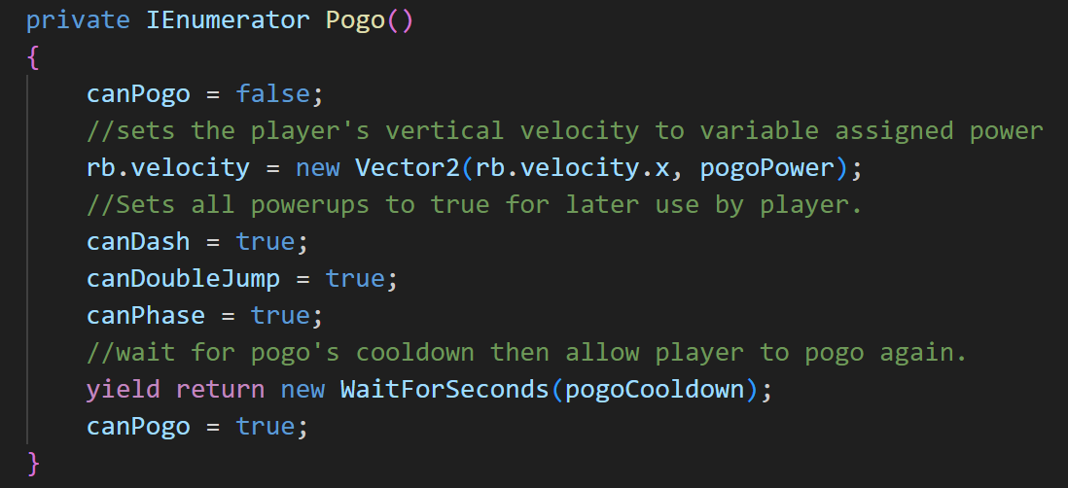
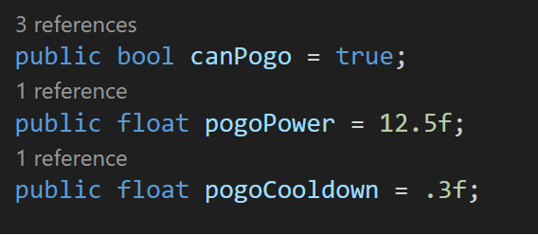
Code

Slide 16
Challenge #4 – Checkpoints
Goal: Create open ended checkpoints that automatically saves the player’s position and respawns them after they die.
Challenge: Code shouldn’t have to be altered to add a new checkpoint.

Slide 17
Solution
Create a Vector3 variable for remembering the player’s current coordinates. Create a trigger box under a specified layer (i.e. Layer 13) that is programmed to update a variable when that player walks through it.

Slide 18
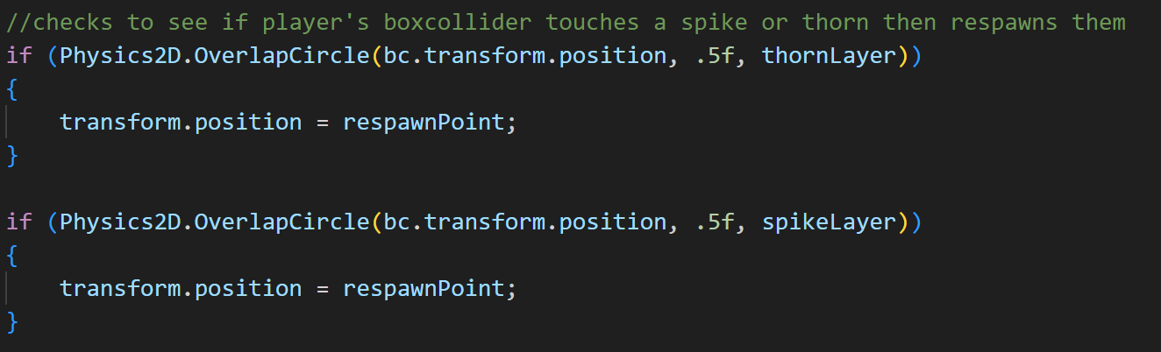
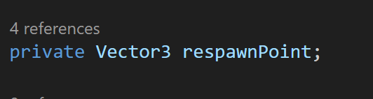
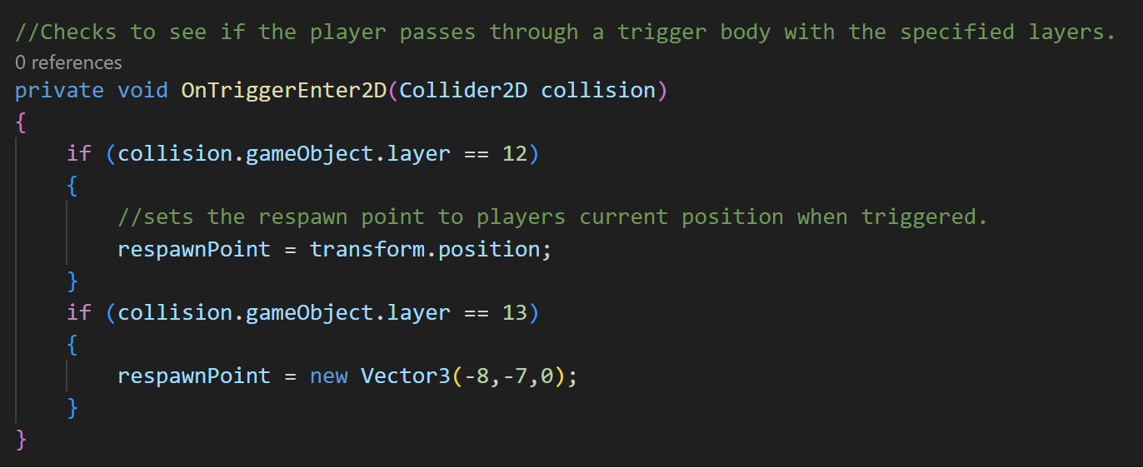
Code

Slide 19
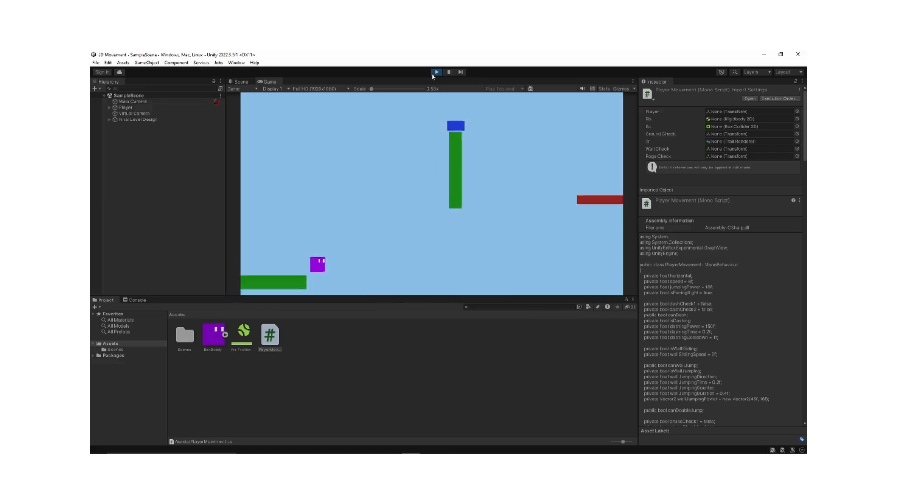
Full Run through

